Slide 1

Cost Function
Data Analytics Department Bridgerland Technical College

Slide 2
Content
Cost Function
Definition of Cost Function
Difference between loss function and cost function
Types of Cost Function in machine learning

Slide 3
Cost Function: Definition
Since it is necessary for a machine learning model to have a high level of accuracy to perform well for the real-world applications, we need a way to measure (how good or poor) the model performance in the real world.
Cost function determines how well the machine learning model performs for a given data by calculating the difference between the actual and predicted value.

Slide 4
Cost Function: Definition
In other words, cost function is a measure of the error between the actual value and the predicted value.
Cost functions are learning parameters and used in the supervised learning algorithms that use optimization techniques.
There are different types of cost functions depending on the task: Regression or classification.

Slide 5
Difference between loss and cost function
Loss function is the difference between the actual and predicted value.
This function quantifies the loss in machine learning during the training phase.
Difference:
Loss function is used when we refer to the error for a single training example.
Cost function is used when we refer to an average of the loss functions over the whole training set.

Slide 6
Cost Function: Types
Cost Functions for Regression Problems
Cost Functions for Classification Problems

Slide 7
Cost Functions for Regression Problems
In a regression problem, the model predicts an output value for each training data during the training stage.
The cost functions for regression problems are calculated as follows:
Error = y – y’
where actual output is y and the regression model predicts y’.
This error is known as distance-based error

Slide 8
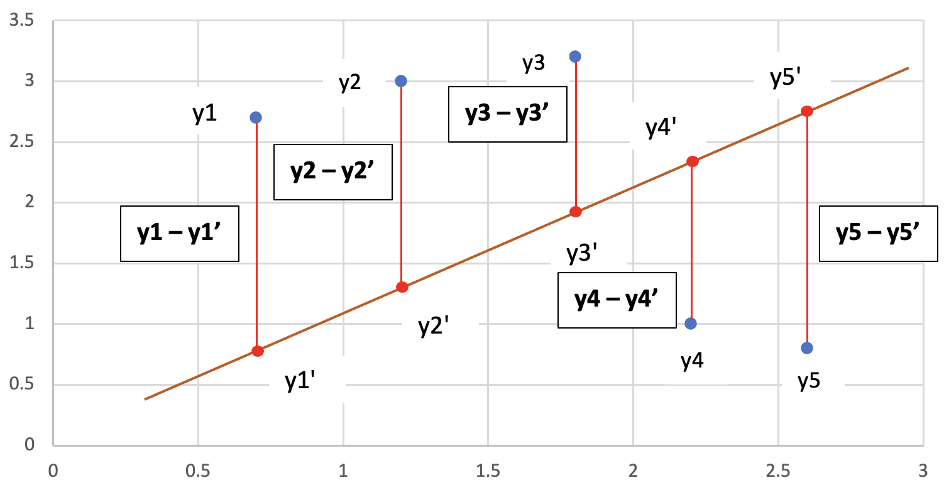
Cost Functions for Regression Problems
This graph shows a representation of the distance-based error.
The blue dots are the actual values.
The red dots are the predicted values.
The orange line is the regression line.
The vertical red lines show the distance between the actual value and the predicted value: y – y’

Slide 9
Cost Functions for Regression Problems
There are several cost functions for regression models:
Mean Error (ME)
Mean Squared Error (MSE)
Mean Absolute Error (MAE)

Slide 10
Cost Functions for Regression Problems
Mean Error (ME): Calculate the ME as follows:
Calculate the error for each training data: y - y’
Calculate the mean value of the errors from Step 1
by adding all those errors and divide the sum by the
number of values in the data set:
ME = (Sum of errors)/(Number of training data)

Slide 11
Cost Functions for Regression Problems
Mean Error (ME): Disadvantages
When we calculate the errors, we can get both negative and positive so they can cancel each other when we sum them which can give zero mean error for the model.
It is not recommended but it helps for the next cost functions that we will analyze later.

Slide 12
Cost Functions for Regression Problems
Mean Squared Error (MSE): Calculate the MSE
Calculate the error for each training data: y - y’
Calculate the square of each error: (y - y’ )^2
Calculate the mean value of the squared errors from Step 2
by adding all those squared errors and divide the sum by the number of values in the data set:
MSE= (Sum of squared errors)/(Number of training data)

Slide 13
Cost Functions for Regression Problems
Mean Squared Error (MSE):
MSE is known as L2 loss.
When we calculate the square of the difference between the actual and predicted value, we avoid any negative error, so this cost function is an improvement of the ME.

Slide 14
Cost Functions for Regression Problems
Mean Absolute Error (MAE): Calculate the MAE:
Calculate the error for each training data: y - y’
Calculate the absolute of each error: | y - y’ |
Calculate the mean value of the absolute errors from Step 2
by adding all those absolute errors and divide the sum by the number of values in the data set:
MAE= (Sum of absolute errors)/(Number of training data)

Slide 15
Cost Functions for Regression Problems
Mean Absolute Error (MAE):
MAE is known as L1 loss.
When we calculate the absolute of the difference between the actual and predicted value, we avoid any negative error, so this cost function is an improvement of the ME as well.

Slide 16
Cost Functions for Regression Problems
Which one to choose between MSE vs MAE?
MSE helps to penalize small errors (compared to MAE).
When data has outliers and we square them, the squared error would magnify the final MSE error so compared to MAE, it would be very big.

Slide 17
Cost Functions for Regression Problems
Which one to choose between MSE vs MAE?
When we have a noisy data (or with outliers), then MAE is better.
When we have a data free from noise and outliers, then MSE is better.

Slide 18
Cost Functions for Classification Problems
In a classification problem, we know that the model gives us a probability distribution of the classes as output for a given input data.
The class that has the highest probability is the winner class for prediction.

Slide 19
Cost Functions for Classification Problems
Since these classification problems require knowledge of probability, we will only mention the cost functions for these type of problems:
Cross entropy
Multi-class cross entropy Loss
Hinge Loss

Slide 20

Reference
ML concepts: https://ml-concepts.com/2022/03/08/cost-functions/

Slide 21

Questions?

